Slide 1
Cloud Technology Fundaments 21UCA501

Slide 2
Pods, aggregation, and silos
Workloads support a certain number of users, at which point you exceed the load that the instance sizing allows. When you reach the limit of the largest virtual machine instance possible, you must make a copy or clone of the instance to support additional users. A group of users within a particular instance is called a pod. Pods are managed by a Cloud Control System (CCS). In AWS, the CCS
is the AWS Management Console. Sizing limitations for pods need to be accounted for if you are building a large cloud-based application. Pods are aggregated into pools within an IaaS region or site called an availability zone. In very large cloud computing networks, when systems fail, they fail on a pod-by-pod basis, and often on a zone-by-zone basis. For AWS’ IaaS infrastructure, the availability zones are organized around the company’s data centers in Northern California, Northern Virginia, Ireland, and Singapore.

Slide 3
Pods, aggregation, and silos
A Failover system between zones gives IaaS private clouds a very high degree of availability. shows how pods are aggregated and virtualized in IaaS across zones. When a cloud computing infrastructure isolates user clouds from each other so the management system is incapable of interoperating with other private clouds, it creates an information silo, or simply a silo. Most often, the term silo is applied to PaaS offerings such as Force.com or QuickBase, but silos often are an expression of the manner in which a cloud computing infrastructure is architected. Silos are the cloud computing equivalent of compute islands: They are processing domains that are sealed off from the outside.

Slide 4
Pods, aggregation, and silos
When you create a private virtual network within an IaaS framework, the chances are high that you are creating a silo. Silos impose restrictions on interoperability that runs counter to the open nature of build-componentized service-oriented applications. However, that is not always a bad thing. A silo can be its own ecosystem; it can be protected and secured in ways that an open system
can’t be. Silos just aren’t as flexible as open systems and are subject to vendor lock-in.

Slide 5
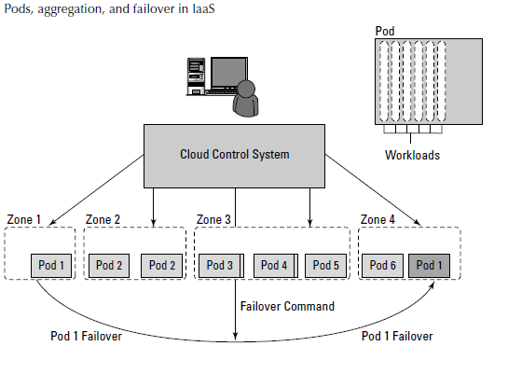
Pods, aggregation, and silos

Slide 6
THANK YOU

